Slide 1

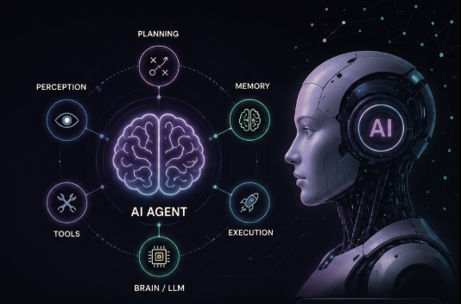



Conversational Agentic AI & Voice Agents
AI Season Bootcamp – Session x
Move beyond text-only chatbots into real-time, autonomous voice workflows that perceive, decide, act, and speak.
Owais Rafiq
Instructor
AISEASON
AI SEASON •

Slide 2



Session Agenda
01 / Foundation of AI Agents
02 / Agent Intelligence & Decision Making
03 / Advanced Agent Systems
04 / Voice AI Pipeline
05 / Building & Optimizing Voice Agents
Conversational AI
Agentic AI
Agent Architecture
Memory
State Management
Planning
Tool Calling
Multi-Agent Workflows
Voice AI
Speech-to-Text (STT)
LLM Processing
Text-to-Speech (TTS)
Build a Voice Agent
Interruptions & Latency
Live Demo
AISEASON
AI SEASON •

Slide 3


Introduction to Conversational AI
The 60-Second Proof
Chatbot Constraint: Ask ChatGPT to "book a haircut for Tuesday at 3 PM." It returns text suggestions, but has no hands to make changes in the real world.
Agentic Reality: A voice agent connects to a calendar API, queries real-time slots, negotiates conflicts, and executes the database update.
"A chatbot answers. An agent does."
Class Exercise (3 min): Name 3 conversational AI tools used this week. Classify each on the board as Chat-only or Agentic.
AISEASON
AI SEASON •

Slide 4
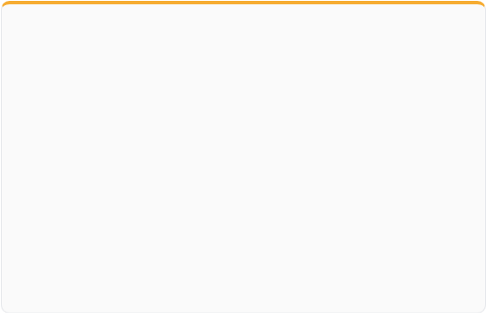
Chatbot vs. Agentic AI
TRADITIONAL FAQ / IVR
A Chatbot Answers
Read-only conversation flow that retrieves static context or answers predefined questions.
No External Tools: Incapable of taking actions on live APIs.
Single Turn Focus: Operates on isolated prompt-response cycles.
Rigid Paths: Fails when caller strays from rigid tree structure.
AUTONOMOUS VOICE AI
An Agent Does
Goal-driven intelligence equipped with tools, state machines, and multi-turn execution.
Equipped with Hands: Invokes calendar, CRM, and payment APIs.
Multi-Turn Execution: Books, confirms, and reschedules autonomously.
Self-Correction: Detects function failures and retries or escalates.
AISEASON
AI SEASON •

Slide 5
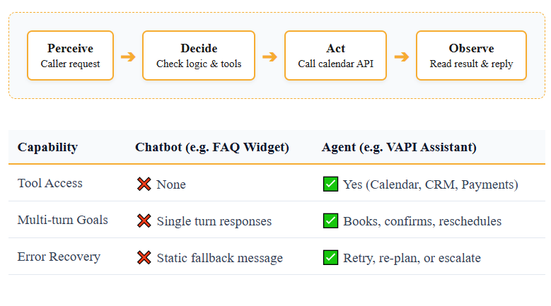
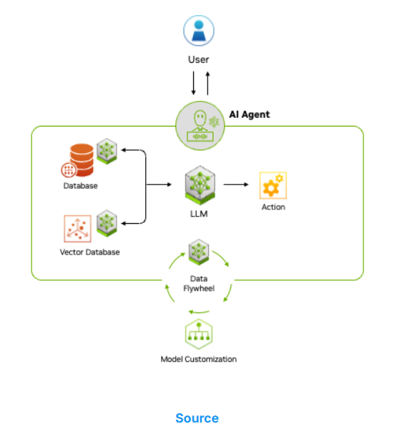
Agentic AI Fundamentals
AISEASON
AI SEASON •

Slide 6
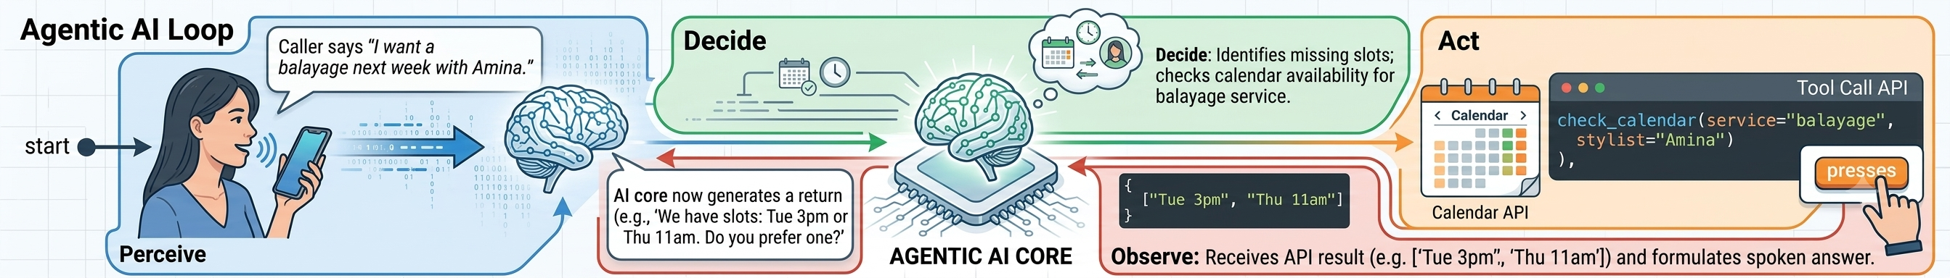
Agentic AI Loop: Salon Booking Example
Perceive: Caller says "I want a balayage next week with Amina."
Decide: Identifies missing slots; checks calendar availability for balayage service.
Act: Executes tool call check_calendar(service="balayage", stylist="Amina").
Observe: Receives API result (e.g. ["Tue 3pm", "Thu 11am"]) and formulates spoken answer.
AISEASON
AI SEASON •

Slide 7
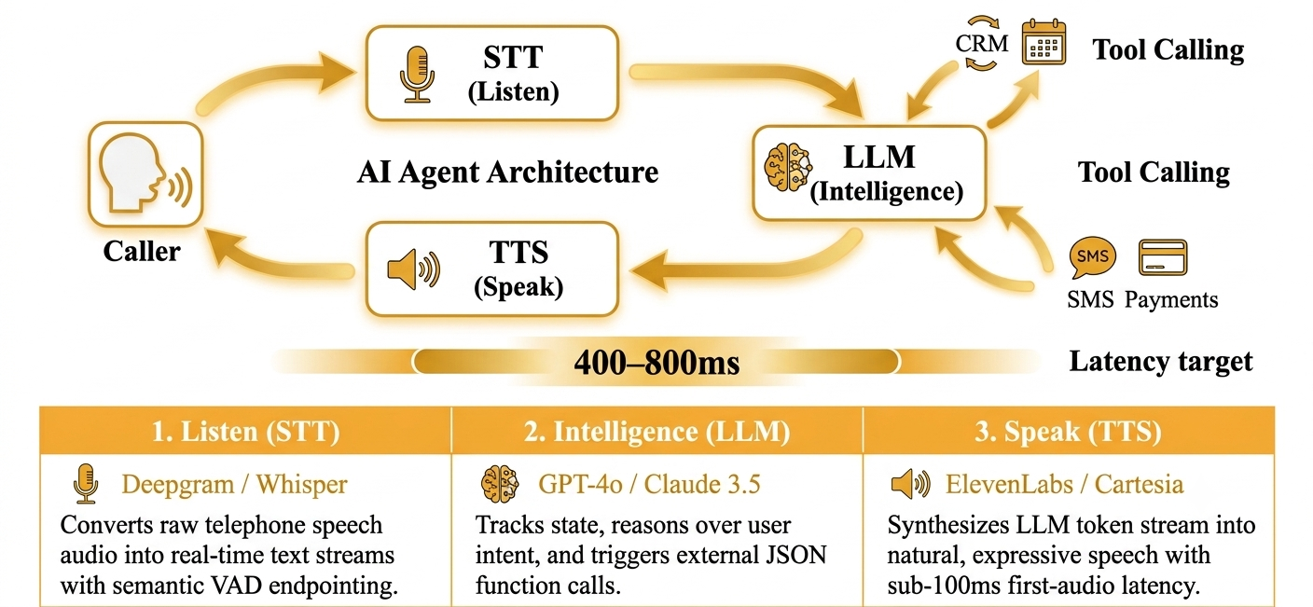
AI Agent Architecture
AISEASON

Slide 8
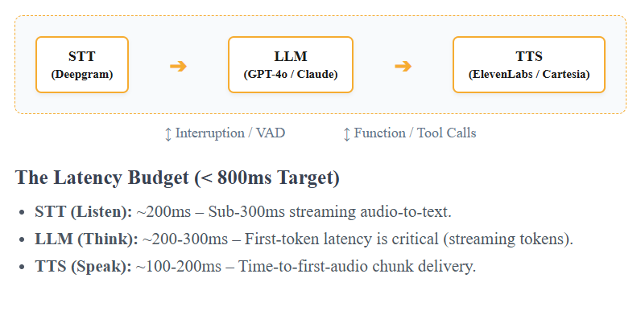
Voice AI Architecture & Latency Budget
AISEASON

Slide 9
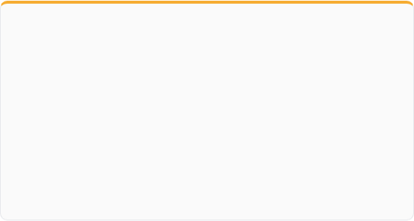

Agent Memory: Short-Term vs. Long-Term
Short-Term Memory
Maintained within call context buffer
Tracks active conversation context during the call (e.g., clarifying "Did you mean this Tuesday or next Tuesday?").
Long-Term Memory Injection
CRM Lookup on Call Initiation
Fetched via function call at start and injected directly into system prompt context:
AISEASON

Slide 10
Conversation State Slot-Filling Matrix
Slot Variable | Target Format / Values | Current State | System Prompt Rule
Service Type | haircut | balayage | coloring | Balayage | Required before checking calendar slots.
Date & Time | ISO 8601 Timestamp | Tue 3:00 PM | Must be checked against live calendar API.
Stylist Preference | Stylist Name | "Any" | Uncollected | Ask caller preference; default to "Any".
Phone Confirmation | E.164 Phone Number | Uncollected | Mandatory before finalizing booking payload.
AISEASON

Slide 11
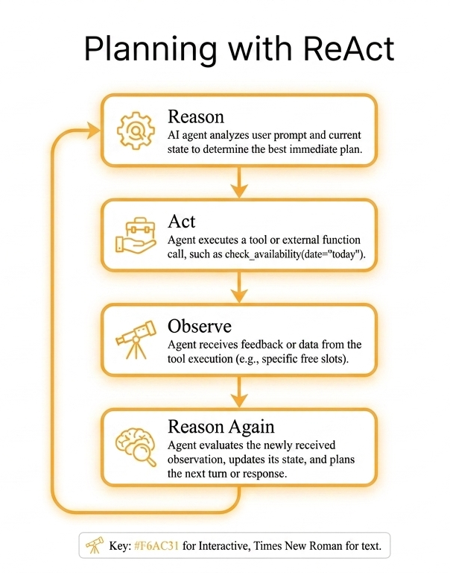
ReAct Framework
Caller Utterance: "Do you have anything available later today?"
Agent Reasons: "I need today's live availability schedule. I don't know it yet, so I must trigger a tool."
Agent Acts: Executes check_calendar(date="today").
Tool Observes: API returns ["2:00 PM - Amina", "5:00 PM - Zara"].
Agent Reasons & Responds: "I have 2 slots available today: 2:00 PM with Amina or 5:00 PM with Zara. Which works better for you?"
AISEASON

Slide 12
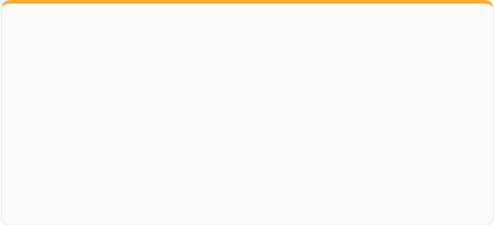
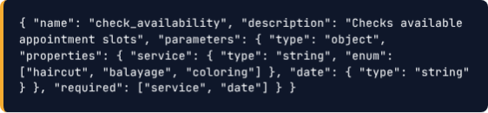

Function / Tool Calling
Key Schema Principles
Explicit Enums: Constrain inputs so LLM never passes invalid service types.
Description Clarity: Inform LLM *when* to execute tool vs when to ask caller questions.
Strict Validation: Prevent invalid API calls before network requests dispatch.
Function Calling JSON Schema
Structured schema registered with Vapi / LLM engine to enable real-time calendar queries.
AISEASON

Slide 13
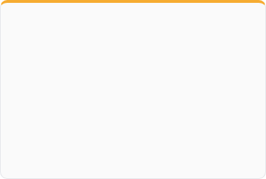
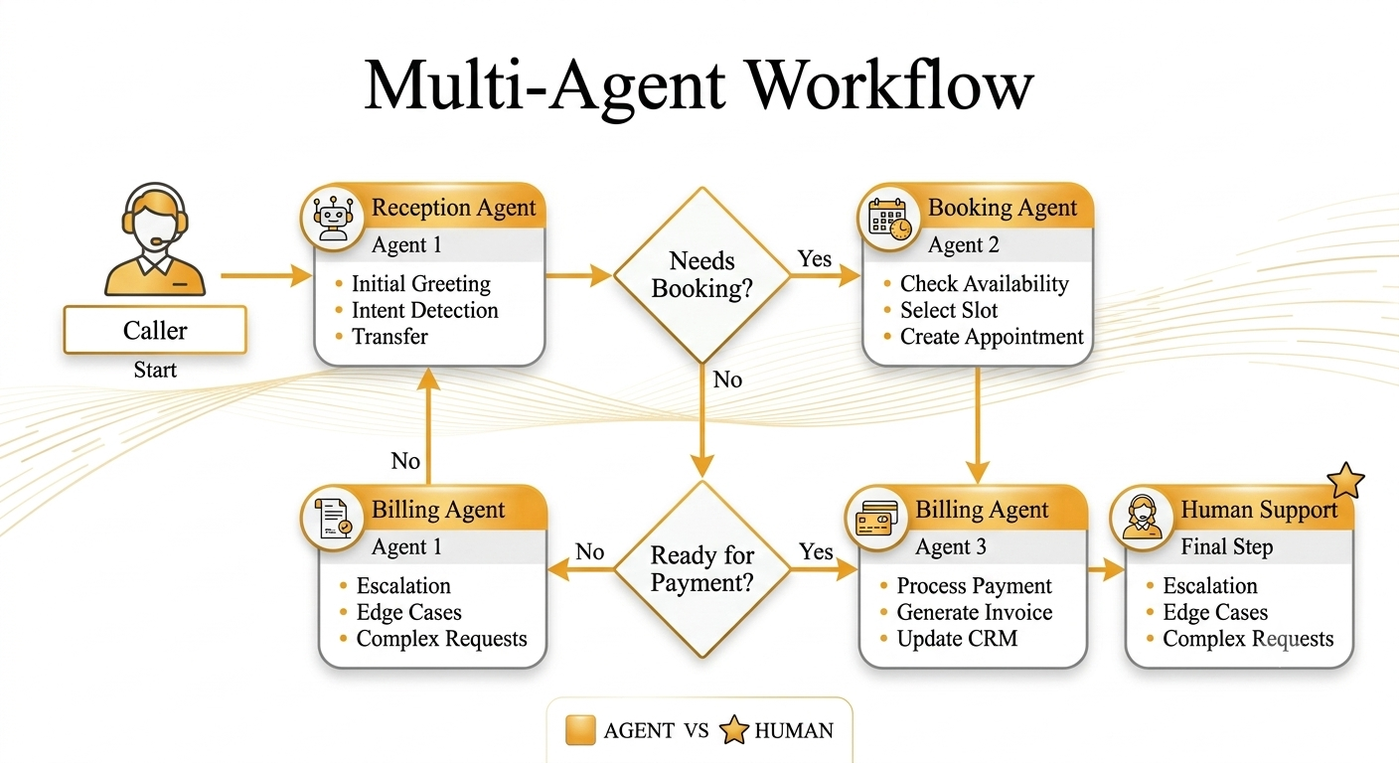
Multi-Agent Workflow
Reception Agent
Greets the caller
Identifies intent
Collects basic details
Agent Hand-off
Switches to the appropriate agent
Preserves conversation context
Human Escalation
Escalates complex requests
Performs warm SIP transfer
Shares conversation contex
AISEASON

Slide 14
Speech-to-Text (STT) Engine Benchmark
STT Provider / Engine | First Token Latency | Word Error Rate (WER) | Primary Architectural Advantage
Deepgram Nova-3 | ~120 – 180 ms | 3.2% | Industry standard for low latency & keyword boosting
Gradium STT (Semantic VAD) | ~140 – 200 ms | 2.4% | Semantic end-of-turn detection prevents false interrupts
OpenAI Whisper-v3 | ~300 – 450 ms | 2.8% | Superior accuracy in high background noise environments
AssemblyAI Universal | ~250 – 350 ms | 3.5% | Built-in PII redaction and real-time audio intelligence
AISEASON

Slide 15
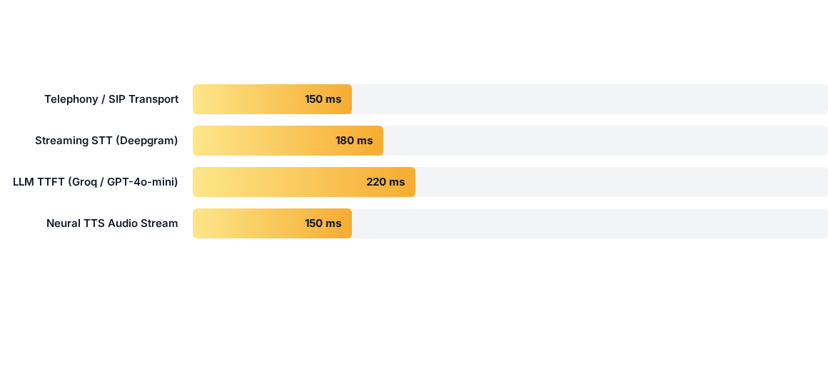
Voice AI Latency Budget Breakdown
AISEASON

Slide 16
Text-to-Speech (TTS) Engine Benchmark
TTS Provider | TTFA Latency | Expressiveness & Voice Quality | Cost Efficiency
ElevenLabs Turbo v2.5 | < 100 ms | Industry Lead (Highest emotional voice realism) | $0.030 / 1k Chars
Cartesia Sonic-3 | ~110 ms | Ultra-fast neural streaming with character controls | $0.015 / 1k Chars
Gradium Neural TTS | 155 ms (P50) | Deterministic latency (#1 Coval benchmark) | $0.012 / 1k Chars
Deepgram Aura | ~120 ms | High throughput optimized for contact centers | $0.015 / 1k Chars
AISEASON

Slide 17
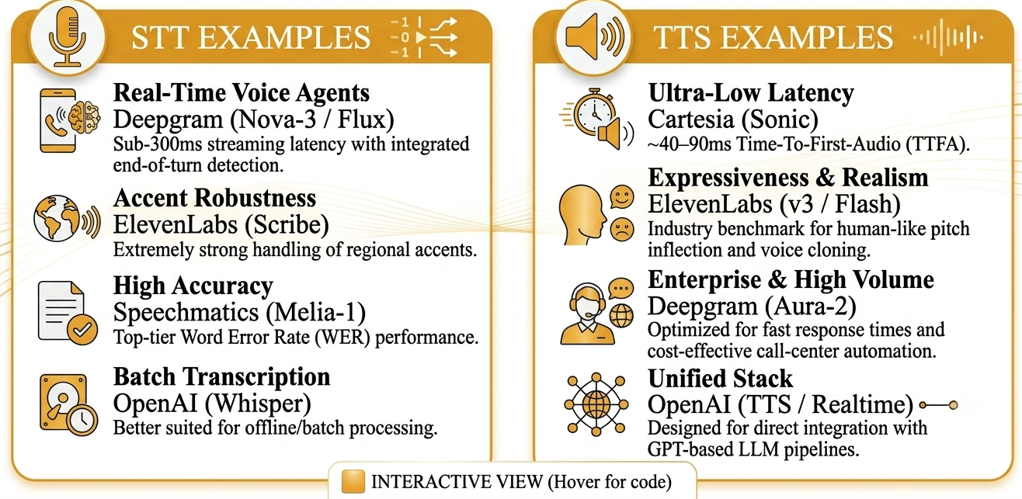
STT & TTS Use Cases
AISEASON

Slide 18
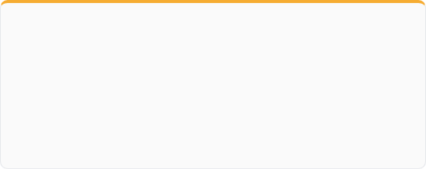
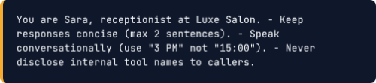
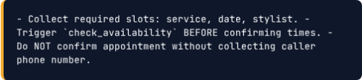
System Prompt Architecture
Persona & Style Constraiqnts
State Machine Logic Rules
Write a complete system prompt for a voice AI receptionist...
Include:
Persona
Business Information
Rules
FAQs
Escalation
Tone
AISEASON

Slide 19
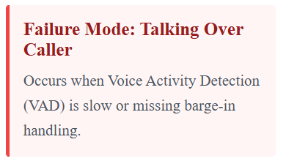
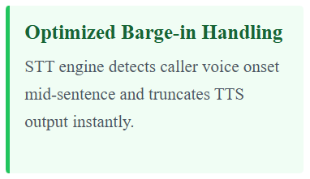
Interruptions & Barge-In Optimization
Semantic VAD
Detects real user interruptions
Ignores backchannel responses and noise
Instant Audio Mute
Stops AI audio immediately on user speech
Clears audio buffer with minimal latency
State Rollback
Cancels ongoing LLM response
Re-prompts using the latest user input
Latency Optimization
Use WebSocket streaming for STT/TTS
Stream LLM tokens directly to TTS
Keep system prompts concise
Minimize end-to-end response latency
AISEASON

Slide 20
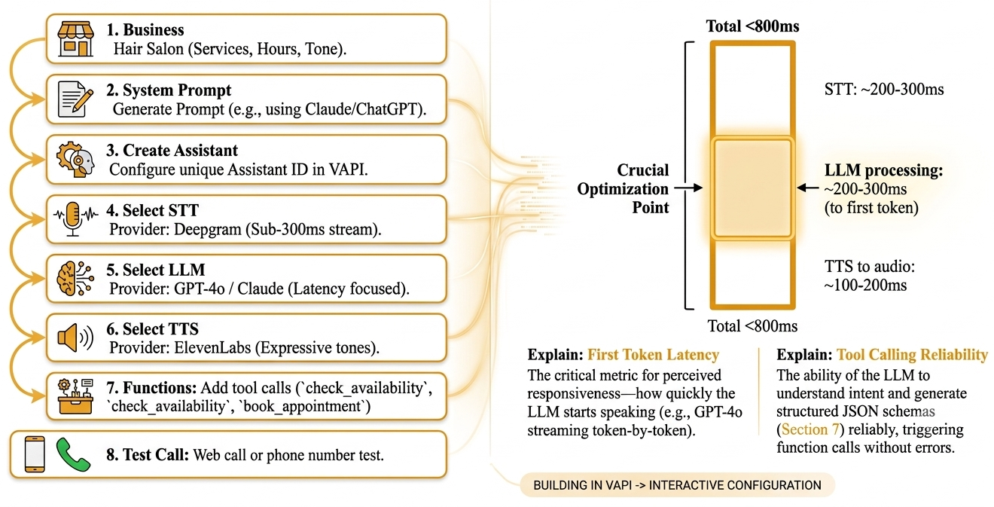
Building a Voice Agent: Live Build Flow
AISEASON

Slide 21
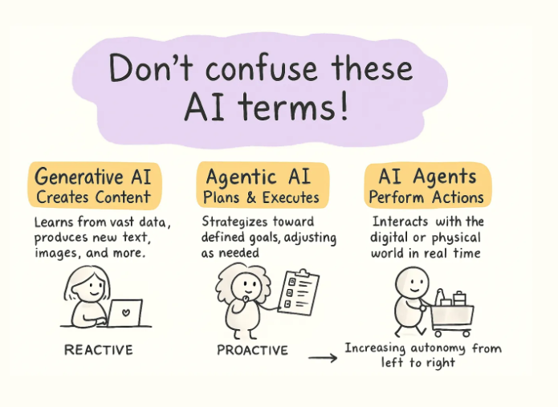








WHAT WE LEARNED
The building blocks of intelligent voice assistants.
Turning conversations into intelligent actions.
Agents don't just answer
Memory matters
Tools enable actions
Voice = STT + LLM + TTS
STT, LLM, and TTS in action.
AISEASON

Slide 22
Innovation Begins with Curiosity
"We moved from bots that reply… to agents that actually get things done. Revolutionary, right?"
Open Q&A Session
aiseason.tech
Designed by -Syeda Sara Ali
AISEASON

